Slide 1



Give For Society
R E G . 1 2 5 5 / 2 0 1 7 · H Y D E R A B A D
C S R P A R T N E R S H I P P R O P O S A L A C A D E M I C Y E A R 2 0 2 6 – 2 7
M E N S T R U A L H Y G I E N E & D I G N I T Y I N I T I A T I V E
Sthree
Swabhiman
Dignity, awareness, and safe infrastructure for 1,23,000 adolescent girls across 275 government residential institutions in Telangana.
I N P A R T N E R S H I P W I T H
MJPTBCWREIS
G O V E R N M E N T O F T E L A N G A N A
★ T E L A N G A N A G O V E R N O R ' S E X C E L L E N C E A W A R D 2 0 2 5
0 1

Slide 2
S T H R E E
S W A B H I M A N
0 2 · E X E C U T I V E S U M M A R Y
E X E C U T I V E S U M M A R Y
A government-partnered programme to end period absenteeism, shame, and unsafe disposal across 275 campuses.
Sthree Swabhiman is a structured Menstrual Hygiene Management initiative for adolescent girls in MJPTBCWREIS residential schools and junior colleges across Telangana — combining annual awareness, sanitary napkin starter kits, permanent incinerator infrastructure, and Training of Trainers.
I M P L E M E N T I N G
A G E N C Y
Give For Society
The programme is endorsed by a Memorandum of Collaboration with the Secretary, MJPTBCWREIS, and a pilot launched in November 2025 in Warangal reached 1,200+ students.
G O V T . P A R T N E R
MJPTBCWREIS
I N S T I T U T I O N S
275 girls-only campuses
₹8.04Cr
T O T A L F U N D I N G A S K
1 yr
P R O G R A M M E C Y C L E
3 yr
T O S E L F - R E L I A N C E
R E A C H
~1,23,000 girls annually

Slide 3
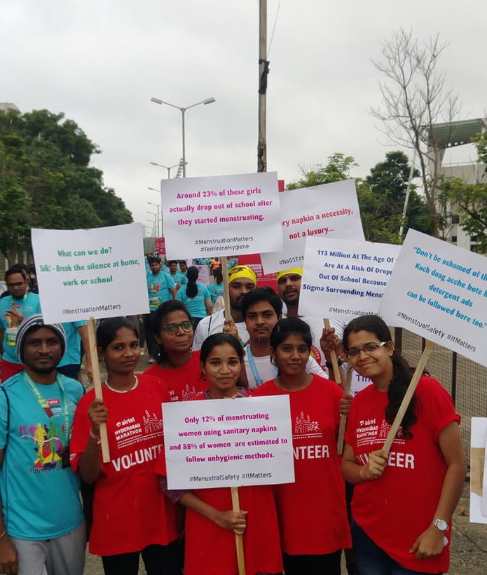
For a girl in a rural residential school, her period costs her four school
days every month.
0 3 · T H E P R O B L E M
T H E P R O B L E M
Across MJPTBCWREIS campuses, menstruation collides with three failures at once: no awareness, no reliable products, and nowhere safe to dispose of waste. The result is silence, shame, and absence.
★ T E L A N G A N A G O V E R N O R ' S E X C E L L E N C E A W A R D 2 0 2 5
S T H R E E S W A B H I M A N · 0 3

Slide 4
S T H R E E
S W A B H I M A N
0 4 · W H Y I T M A T T E R S
F O U R R E A L I T I E S O F P E R I O D P O V E R T Y
The scale of the gap, in four numbers.
4–5 | 50% | 0 | 1×
S C H O O L D A Y S L O S T Days each girl in a residential institution misses every month due to menstruation. | U N S A F E A L T E R N A T I V E S Of rural girls still use cloth, paper or ash in place of sanitary protection. | S A F E D I S P O S A L S I T E S Most MJPTBCWREIS campuses have no incinerator — waste is openly burned or buried. | S T R U C T U R E D S E S S I O N S The number of menstrual hygiene sessions most girls receive in their entire schooling.
Source: Programme baseline survey, MJPTBCWREIS pilot, Warangal Dist., Nov 2025.

Slide 5
S T H R E E
S W A B H I M A N
0 5 · O U R R E S P O N S E
O U R R E S P O N S E
A four-part programme, delivered annually, designed to graduate to institutional self-reliance by Year 3.
P I L L A R 0 1 · A W A R E N E S S
Structured MHM sessions in every institution, every year.
One-day workshops on menstrual cycle, hygiene, myth-busting, and emotional well-being — delivered in Telugu.
2 7 5 S E S S I O N S / Y R
P I L L A R 0 2 · A C C E S S
Starter kits placed in the hands of every newly-enrolled girl.
12 sanitary napkin packs per girl, with a user guide and demonstration on safe disposal practice.
8 8 , 0 0 0 K I T S / Y R
P I L L A R 0 3 · I N F R A S T R U C T U R E
Permanent eco-friendly incinerators on every campus.
Two units per institution — a one-time capital investment with a 10+ year service life and on-site training.
5 5 0 U N I T S I N S T A L L E D
P I L L A R 0 4 · C A P A C I T Y
Training of Trainers, so the programme outlives our presence.
Lady wardens, science teachers, and peer-mentor students are certified to deliver content independently.
8 2 5 + T R A I N E D

Slide 6
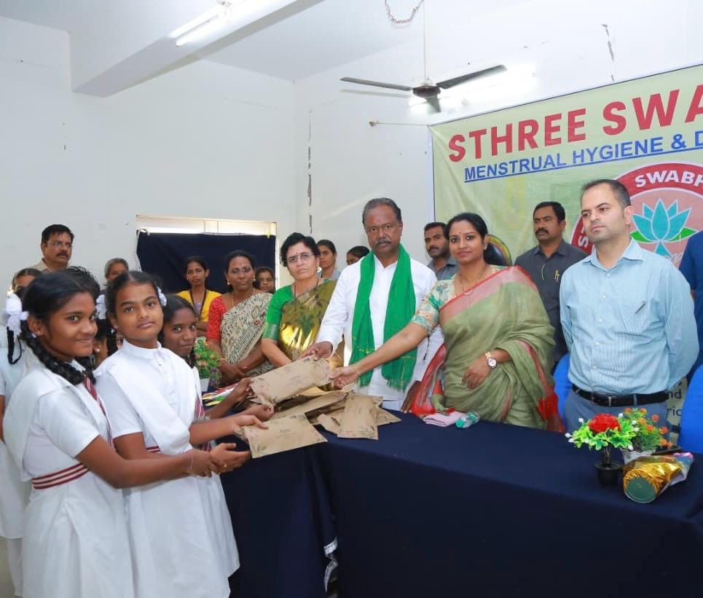
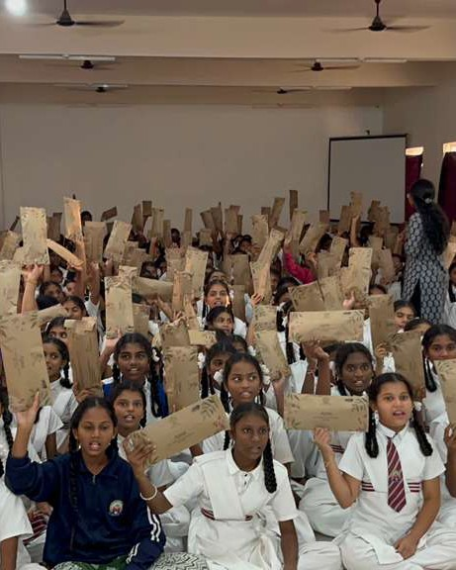
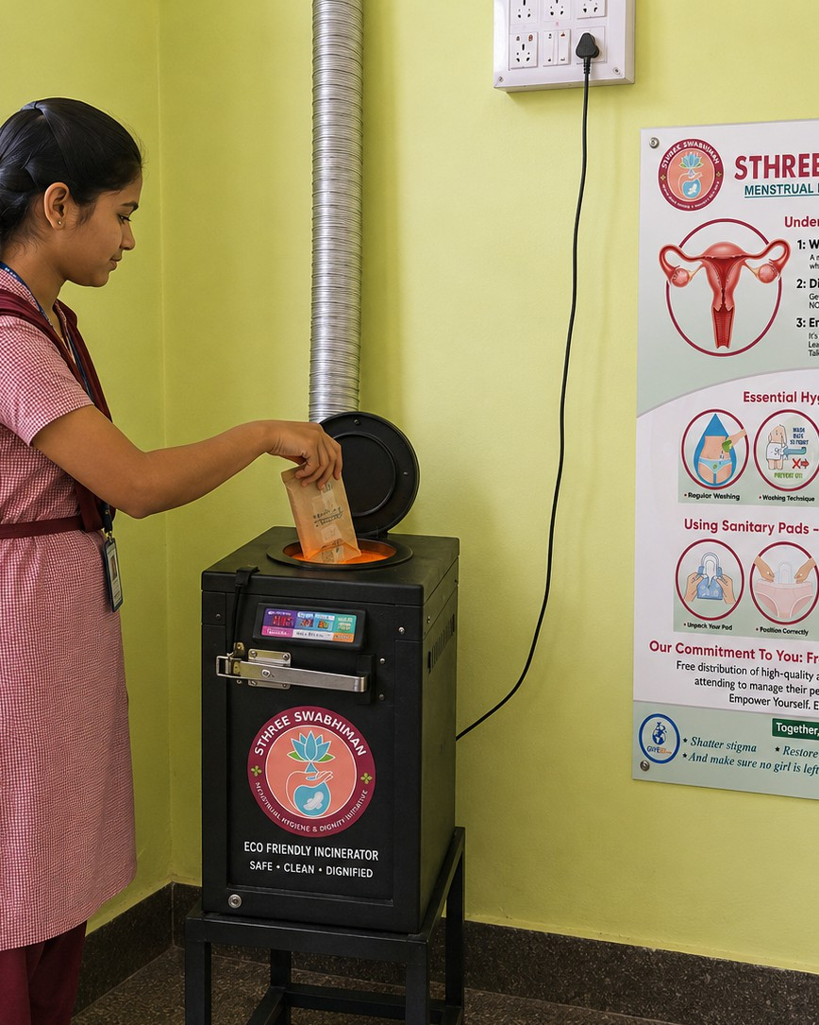
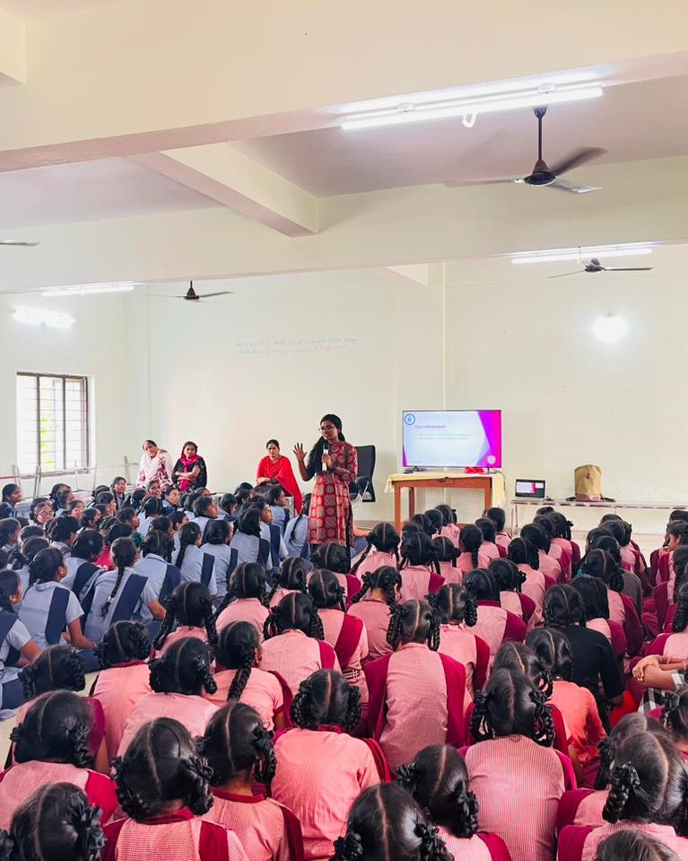
S T H R E E
S W A B H I M A N
0 6 · P R O G R A M M E C O M P O N E N T S
W H A T E A C H G I R L R E C E I V E S
Four interventions, delivered together on every campus.
0 1 · A W A R E N E S S
One-day MHM workshop in every institution.
Menstrual cycle, hygiene, myth-busting, emotional well-being & incinerator use. Telugu flipbooks + facilitator script.
0 2 · A C C E S S
Sanitary napkin starter kits in every girl's hands.
12 packs per newly-enrolled girl, with a printed user guide and live demonstration on safe disposal practice.
0 3 · I N F R A S T R U C T U R E
Permanent eco-friendly incinerators on every campus.
Two units per institution. One-time capital investment with a 10+ year service life and first-year maintenance contract.
0 4 · C A P A C I T Y
Training of Trainers, so the programme outlives us.
Lady wardens, science teachers and senior peer mentors are ToT-certified to sustain delivery from Year 2 onwards.

Slide 7
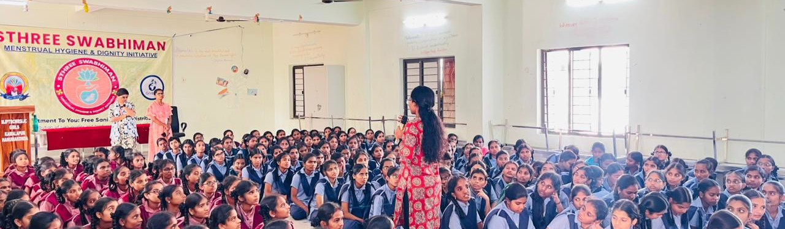
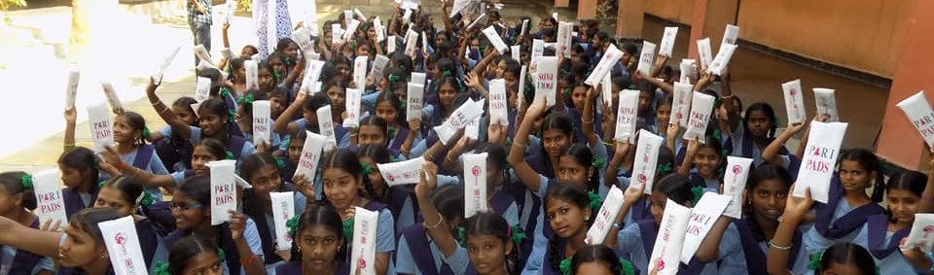
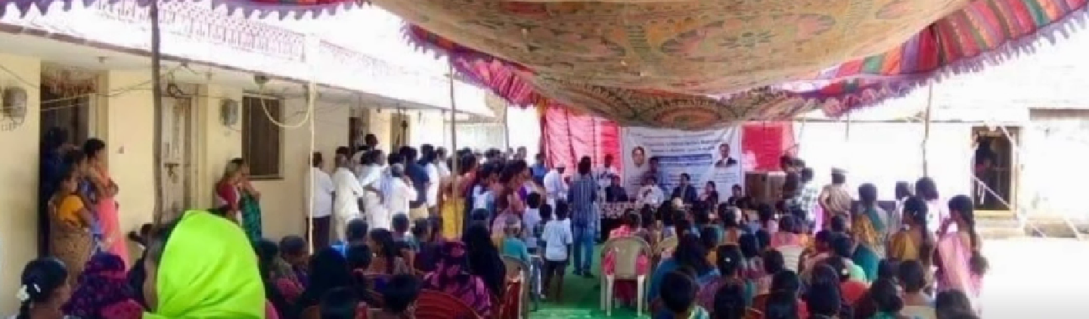
S T H R E E
S W A B H I M A N
0 7 · W H O W E R E A C H
W H O W E R E A C H
Targeting the most underserved adolescent demographic in the state.
275 I N S T I T U T I O N S | 1.23L G I R L S / Y R | 88K K I T R E C I P I E N T S | 10 D I S T R I C T S
146 schools & | Classes VI–XII + | Newly enrolled | All erstwhile
129 jr. colleges | Intermediate I & | each year | districts of
 | II |  | Telangana
M J P T B C W R E I S G I R L S ' C A M P U S · S T H R E E S W A B H I M A N S E S S I O N
C O M M U N I T Y C O M P O S I T I O N
B C
S C
S T
M I N O R I T Y
K I T D I S T R I B U T I O N · C L A S S E S V I – X I I
Every girl reached studies in a government residential institution from a BC, SC, ST, or minority community — the demographic with the steepest barriers to menstrual health, and the lowest baseline of awareness.
C O M M U N I T Y O U T R E A C H · N I R M A L D I S T R I C T

Slide 8


S T H R E E
S W A B H I M A N
0 8 · I M P L E M E N T A T I O N P L A N
I M P L E M E N T A T I O N P L A N
A five-phase annual cycle, anchored to the MJPTBCWREIS academic calendar.
A P R
J U N
J U L
M A R
Q T R
P H A S E 0 1
Planning
Institution lists finalised, principals coordinated, site assessments for incinerators completed.
A P R — M A Y
P H A S E 0 2
Infrastructure & Capacity
550 incinerators installed. ToT workshops with staff. Peer mentors trained on each campus.
M A Y — J U N
P H A S E 0 3
Awareness & Distribution
One-day MHM workshop per institution. Starter kits distributed to every newly-enrolled girl.
J U N — J U L
P H A S E 0 4
Institution-led Continuity
Trained staff and peer mentors carry messaging independently. IEC materials displayed campus-wide.
A U G — M A R
P H A S E 0 5
Monitoring & Reporting
Quarterly warden check-ins, district field visits, incinerator audits, and a year-end impact report.
Q U A R T E R L Y
★ K E Y A C T I V I T I E S C L U S T E R A R O U N D S C H O O L R E O P E N I N G , S O E V E R Y N E W G I R L I S R E A C H E D A T T H E S T A R T O F T H E Y E A R .

Slide 9
S T H R E E
S W A B H I M A N
0 9 · S U S T A I N A B I L I T Y M O D E L
S U S T A I N A B I L I T Y M O D E L
By Year 3, every campus runs the programme on its own — without NGO dependency.
Y E A R | G I V E F O R S O C I E T Y | I N S T I T U T I O N
1 | Full implementation. Sessions, kits, incinerators, ToT delivered end-to-end. | Observe, nominate focal persons, host facilitation.
2 | Partial support. Joint sessions co-delivered with institution staff. | Lead delivery with NGO guidance; manage incinerators independently.
3 | Remote only. Refresher content and technical helpline. | Run programme fully independently; maintain infrastructure.
The investment lasts beyond the funding year. Incinerators have a 10+ year service life. IEC materials are reusable.
Trained staff stay on campus. Peer mentors graduate into the next cohort.
→
No recurring product procurement after Year 1 starter kit.
→
Self-financing pipeline routed through MJPTBCWREIS allocations.
→
Programme survives staff transfers via documented curriculum.

Slide 10



S T H R E E
S W A B H I M A N
1 0 · I M P A C T & K P I S
I M P A C T & K P I S
What we measure, and what we commit to deliver.
275
I N S T I T U T I O N S C O V E R E D
1.23L
G I R L S W I T H A W A R E N E S S
88K
S T A R T E R K I T S
275
A W A R E N E S S S E S S I O N S
550
I N C I N E R A T O R S L I V E
825+
T R A I N E R S C E R T I F I E D
O U T C O M E 0 1
Period-related school absence
O U T C O M E 0 2
Girls using safe sanitary products
O U T C O M E 0 3
Institutions running independently
YR 1
4–5
↓
0%
→
→
YR 2
~60%
A F T E R Y R 1
~50%
B A S E L I N E
Target ↑
A F T E R Y R 1
YR 3
100%
B A S E L I N E
Pre/post attendance logs · days/month
Baseline vs follow-up survey · % of girls
% self-delivering — institution staff & peer mentors

Slide 11

S T H R E E
S W A B H I M A N
1 1 · S D G & P O L I C Y A L I G N M E N T
S D G & P O L I C Y A L I G N M E N T
Contributing to five UN Sustainable Development Goals.
S U S T A I N A B L E D E V E L O P M E N T G O A L
3
Good Health and Well-being
S U S T A I N A B L E D E V E L O P M E N T G O A L
4
Quality Education
S U S T A I N A B L E D E V E L O P M E N T G O A L
5
Gender Equality
S U S T A I N A B L E D E V E L O P M E N T G O A L
6
Clean Water & Sanitation
S U S T A I N A B L E D E V E L O P M E N T G O A L
10
Reduced Inequalities
Promotes menstrual hygiene; reduces RTIs & UTIs; protects physical & emotional well-being.
Cuts menstruation-driven absenteeism; preserves school attendance & academic continuity.
Challenges period stigma; ensures equitable access to dignity, knowledge & menstrual care.
550 eco-friendly incinerators end open-burn pollution across all 275 campuses.
Exclusively serves BC, SC, ST & minority adolescent girls — India's most underserved.
N A T I O N A L P O L I C Y A L I G N M E N T
B E T I B A C H A O B E T I P A D H A O
S W A C H H B H A R A T M I S S I O N
N E P 2 0 2 0
C O M P A N I E S A C T 2 0 1 3 · S C H . V I I ( I , I I , I I I )

Slide 12
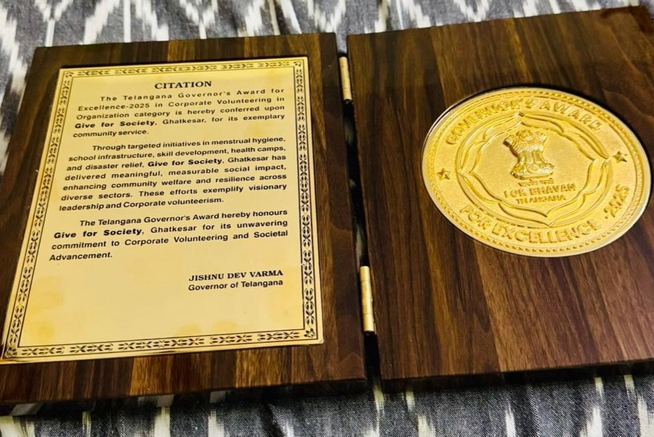
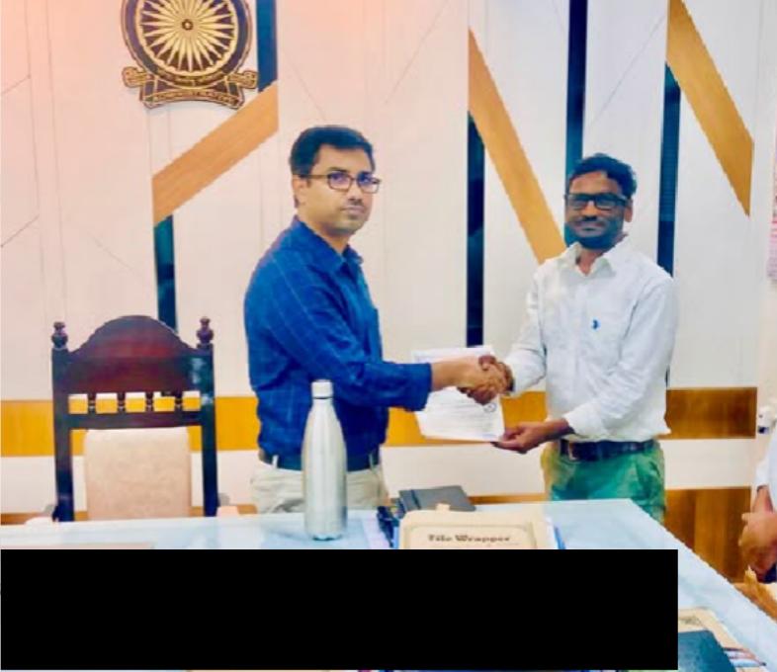
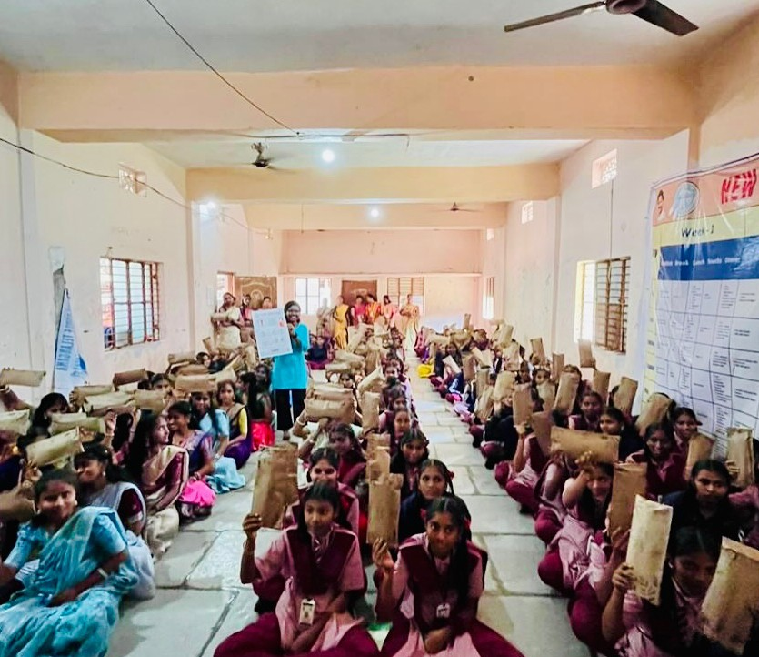
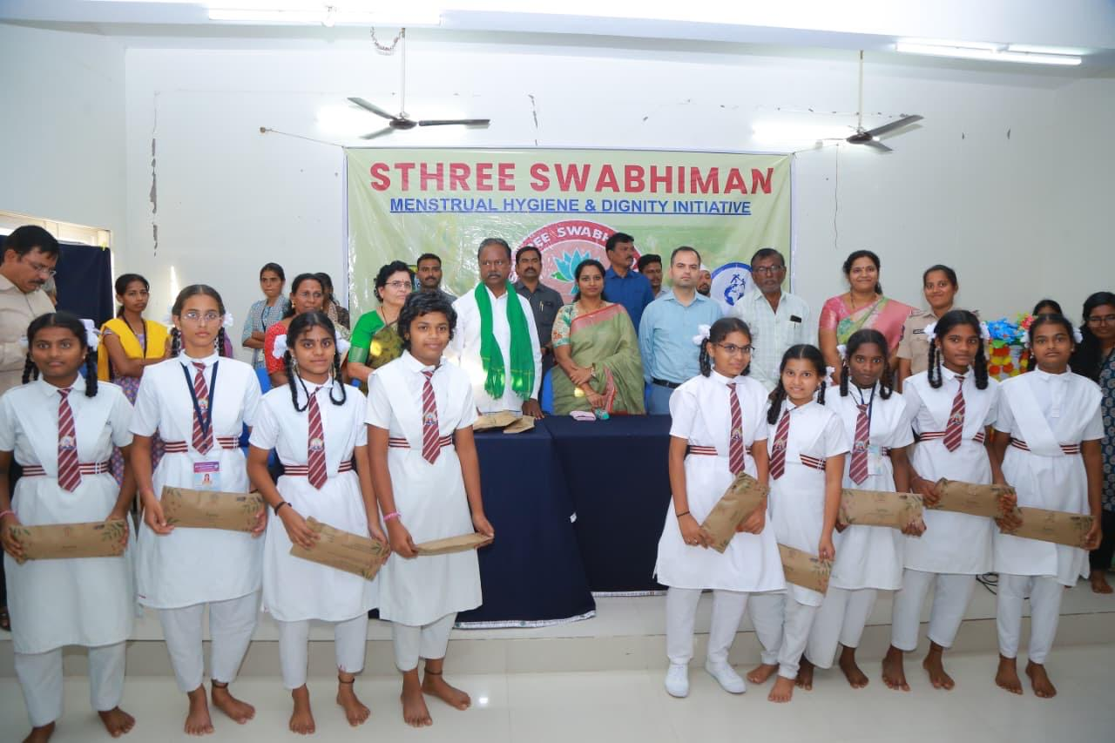



S T H R E E
S W A B H I M A N
1 2 · W H Y G I V E F O R S O C I E T Y
W H Y G I V E F O R S O C I E T Y
Government-endorsed, award-recognised, with a pilot already in the ground.
Governor's Excellence Award
L O K B H A V A N · 7 7 T H R E P U B L I C D A Y
MoC signing
G O V T . O F T E L A N G A N A O F F I C E
★
T E L A N G A N A G O V E R N O R ' S E X C E L L E N C E A W A R D 2 0 2 5
★ A W A R D 2 0 2 5
Corporate Volunteering — Organisation Category. Conferred by Hon'ble Governor Shri Jishnu Dev Varma on the 77th Republic Day, Lok Bhavan, Hyderabad.
§
M O C W I T H M J P T B C W R E I S
Memorandum of Collaboration signed with the Secretary, MJPTBCWREIS — Lr.No.C2/3357/2025. Full institutional access across 275 girls-only campuses.
⌖
P I L O T D E L I V E R E D · N O V 2 0 2 5
1,200+ students reached in Warangal District. End-to-end workshop, kit distribution, and incinerator install documented.
I M P L E M E N T I N G
Give For Society
P R O G R A M M E
Sthree Swabhiman
G O V T . P A R T N E R
MJPTBCWREIS
Pilot launch
M J P T B C W R E I S K A M A L A P U R · H A N U M A K O N D A
Kit distribution
1 , 2 0 0 + S T U D E N T S R E A C H E D

Slide 13
S T H R E E
S W A B H I M A N
1 3 · B U D G E T O V E R V I E W
B U D G E T O V E R V I E W
T O T A L P R O G R A M M E C O S T · A N N U A L
₹8.04Cr
I N R E i g h t C r o r e s F o u r L a k h s S i x t y - S i x T h o u s a n d · ₹ 8 , 0 4 , 6 6 , 0 0 0
P E R - G I R L C O S T
₹600
Year of awareness + 12 napkin packs + incinerator share.
C A P I T A L L I F E S P A N
10+ yr
Incinerators are a one-time investment; recurring cost drops year-on-year.
S C A L E D I S C O U N T
~10%
Estimated bulk procurement savings at full statewide volume.
A · A W A R E N E S S
₹68.75L
Sessions, ToT, peer mentor training, logistics.
8 . 5 % O F T O T A L
B · S T A R T E R K I T S
₹5.28Cr
88,000 girls × 12 packs × ₹45 + packaging & logistics.
6 5 . 6 % O F T O T A L
C · I E C M A T E R I A L S
₹8.25L
Telugu flipbooks, wall charts, lamination treatment.
1 . 0 % O F T O T A L
D · I N C I N E R A T O R S
₹1.38Cr
550 units, installation, first-year maintenance.
1 7 . 1 % O F T O T A L · O N E - T I M E
E · M & E + M A N P O W E R
₹62.16L
Field coordinators, M&E officer, field visits & reports.
7 . 7 % O F T O T A L

Slide 14
S T H R E E
S W A B H I M A N
1 4 · D E T A I L E D B U D G E T
D E T A I L E D B U D G E T B R E A K D O W N
Every line item — verifiable through Schedule VII utilisation certificates.
C O M P O N E N T A
Awareness & Capacity Building
₹68,75,000
C O M P O N E N T B
Sanitary Napkin Starter Kits
₹5,28,00,000
Facilitator costs | ₹2,500 × 275 | ₹25,00,000
Training of Trainers workshops | Lump sum | ₹20,00,000
Peer mentor training materials | Lump sum | ₹15,00,000
Logistics & coordination | Lump sum | ₹8,75,000
Sanitary napkins | 88,000 × 12 × ₹45 | ₹4,75,20,000
Packaging & user guides | Lump sum | ₹22,00,000
Logistics & distribution | Lump sum | ₹30,80,000
C O M P O N E N T D · O N E - T I M E C A P I T A L
Incinerators (550 units)
₹1,37,50,000
C O M P O N E N T C
IEC Materials
₹8,25,000
Incinerator units | 550 × ₹20,000 | ₹1,10,00,000
Installation & electrical | ₹6,000 × 275 | ₹16,50,000
First-year maintenance | 275 institutions | ₹8,25,000
Training on op. & maintenance | Lump sum | ₹2,75,000
Telugu flipbooks & visual aids | Lump sum | ₹4,12,500
Wall charts and posters | Lump sum | ₹2,75,000
Lamination & durability treatment | Lump sum | ₹1,37,500
C O M P O N E N T E
₹62,16,000

Slide 15
S T H R E E
S W A B H I M A N
1 5 · F O R C S R P A R T N E R S
W H A T C S R P A R T N E R S R E C E I V E
Visibility, verification, and compliance
— bundled with the impact.
01
R E C O G N I T I O N
Named partner across all 275 campuses
Co-branding on Telugu IEC materials, session backdrops, and partner credits delivered to 1,23,000 girls.
02
R E C O G N I T I O N
Branded plaques on 550 incinerators
Permanent metal plaques on every unit — a 10+ year visibility footprint anchored to real infrastructure.
03
R E P O R T I N G
Quarterly progress reports with photo evidence
Distribution records, install logs, and institution-wise data — formatted for CSR committee review.
04
R E P O R T I N G
Annual impact report & field-visit access
Year-end documentation, sample field visits, and third-party verification on request.
05
C O M P L I A N C E
Full Schedule VII certification
Utilisation certificates and expenditure data for Companies Act 2013 Schedule VII (Clauses i, ii & iii).
06
C O M P L I A N C E
Government-endorsed delivery chain
Delivered under a signed MoC with MJPTBCWREIS — full cooperation, named focal persons, audit-ready records.

Slide 16

S T H R E E
S W A B H I M A N
1 6 · C A L L T O A C T I O N
C A L L T O A C T I O N
Partner with us — to reach 1,23,000 girls across 275 campuses, starting this academic year.
R O A D M A P T O P A R T N E R S H I P
T H E A S K
₹8.04 Cr
For one full academic year of statewide delivery. Full, partial, or component-specific commitments welcomed.
01
Partnership conversation
A 45-minute review with your CSR committee — fit, scale, disbursement.
02
Site visit & pilot review
Optional visit to the Warangal pilot — observe a session, inspect an install, meet wardens.
03
MoU & milestone-linked disbursement
Sign the MoU; launch with the April–May planning phase.
04
First reach — June 2026
First girls receive kits, training, and access to safe disposal at academic year-start.
O R S C O P E D O W N T H E P A R T N E R S H I P
₹1.38 Cr
A L L 5 5 0 I N C I N E R A T O R S
₹68.75 L
S T A T E W I D E A W A R E N E S S
₹2.92 L
A D O P T 1 I N S T I T U T I O N
N E X T S T E P
Sign the MoU. Reach the first girls by June.
[email protected]

Slide 17
No girl should miss school
because of her period.
T H A N K Y O U
1 7 / 1 7
No campus should lack a safe way to dispose of menstrual waste. Your CSR partnership makes both possible — for 1,23,000 girls, across 275 institutions, starting this academic year.
I M P L E M E N T I N G A G E N C Y
Give For Society
R e g . 1 2 5 5 / 2 0 1 7
P R O G R A M M E
Sthree Swabhiman
M e n s t r u a l H y g i e n e & D i g n i t y
G O V E R N M E N T P A R T N E R
MJPTBCWREIS
G o v t . o f T e l a n g a n a
contact@give4soiety.org
+91 94407 27071
·
H Y D E R A B A D , T E L A N G A N A
·
M O C L R . N O . C 2 / 3 3 5 7 / 2 0 2 5
★ T E L A N G A N A G O V E R N O R ' S E X C E L L E N C E A W A R D 2 0 2 5
S T H R E E S W A B H I M A N · C S R P A R T N E R S H I P P R O P O S A L

